Slide 1
How Deep Learning Works
Gordon Gao
Carey Business School Professor

Slide 2

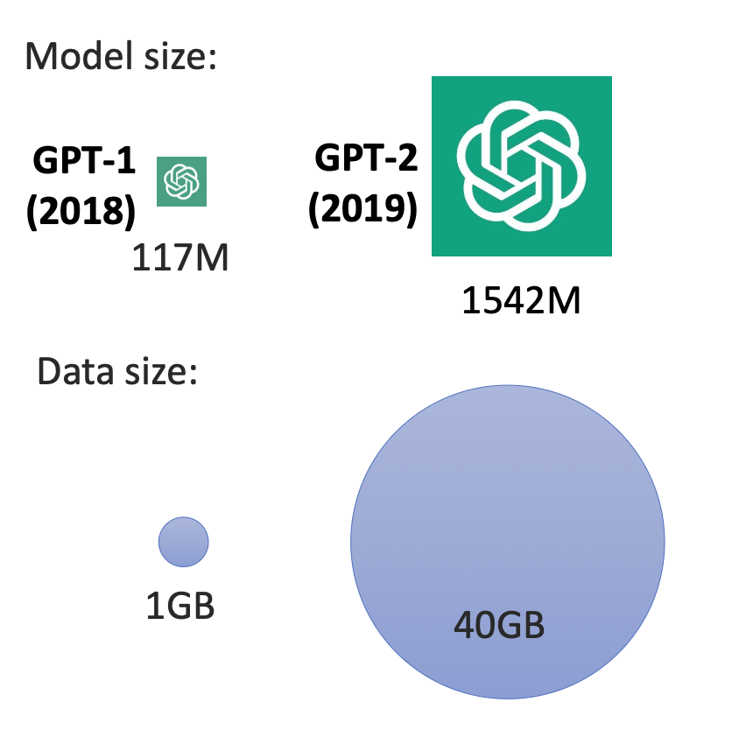
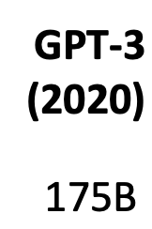
GPT Models before ChatGPT
45 TB

Slide 3
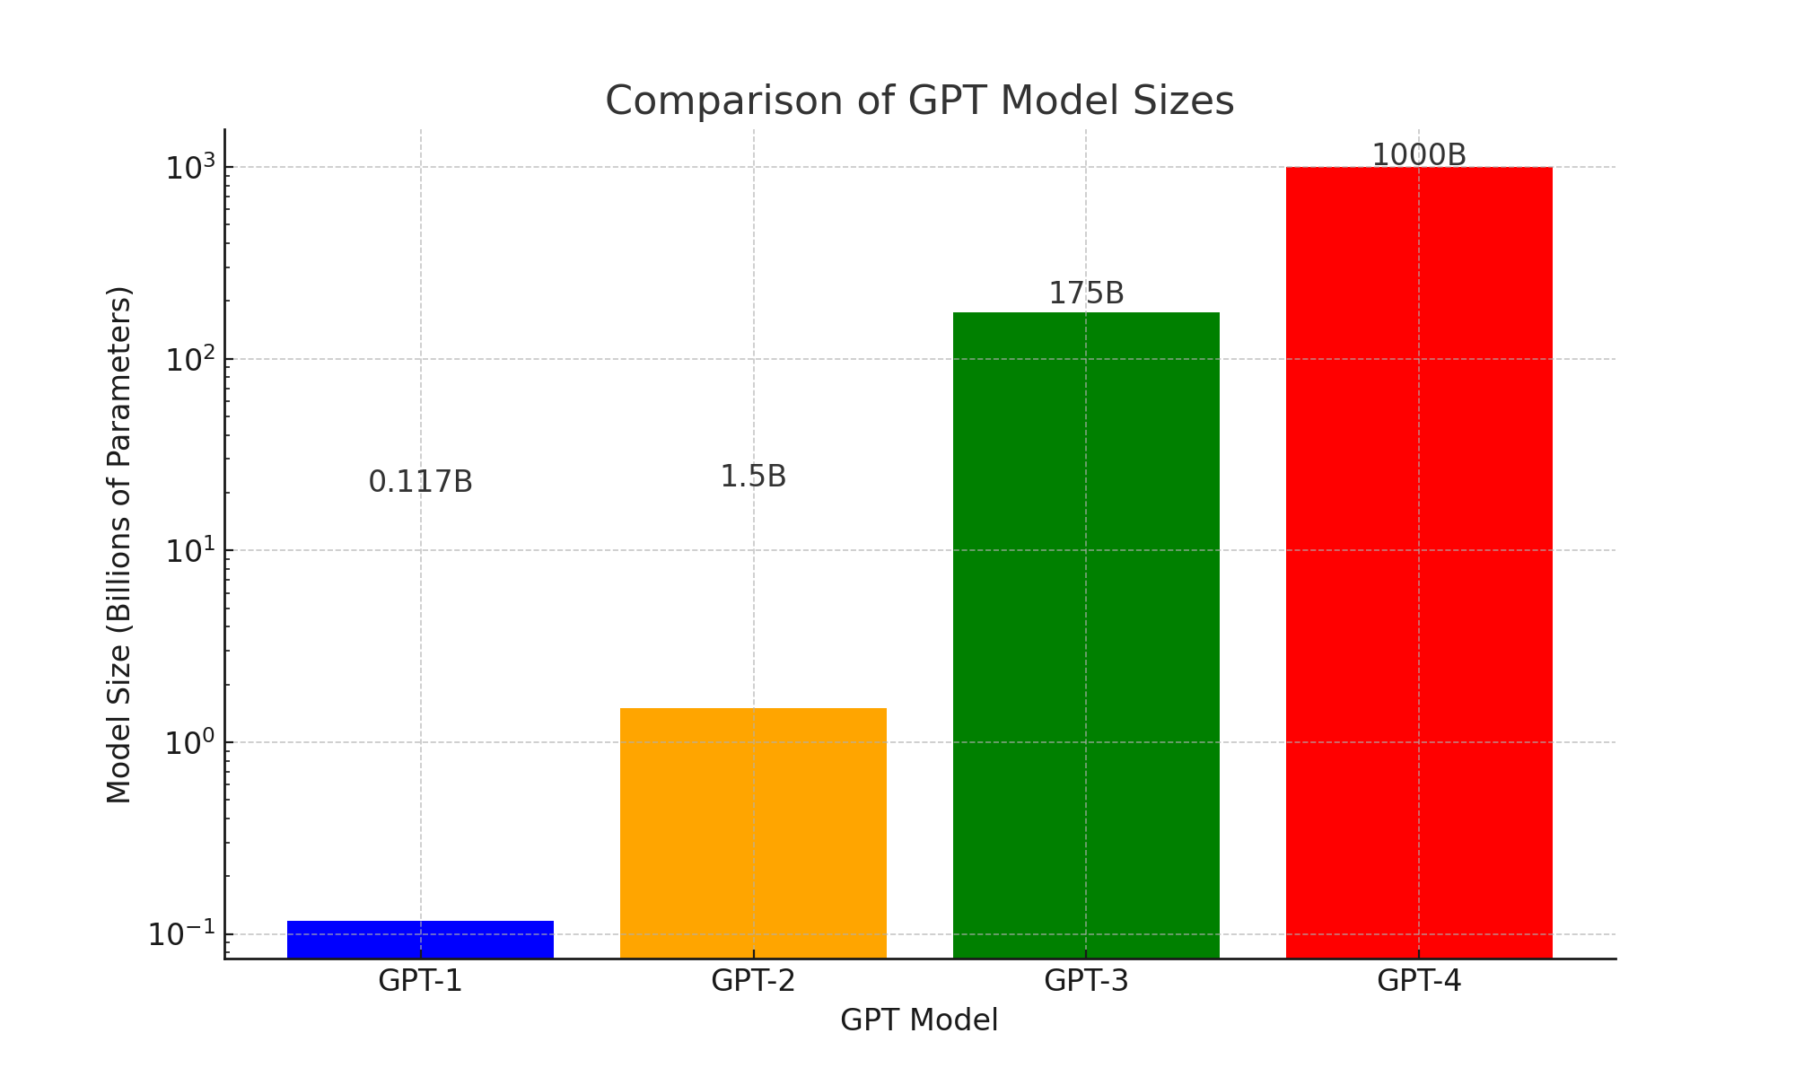
2018
2019
2020
2023

Slide 4
Part 1: How Neurons Work

Slide 5
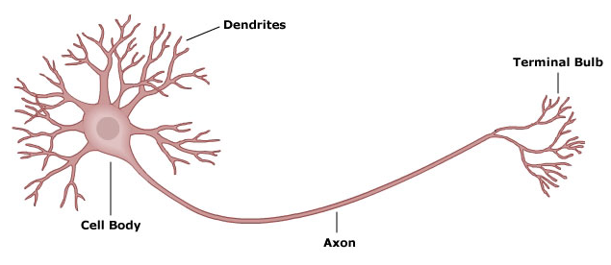
How human neuron works

Slide 6
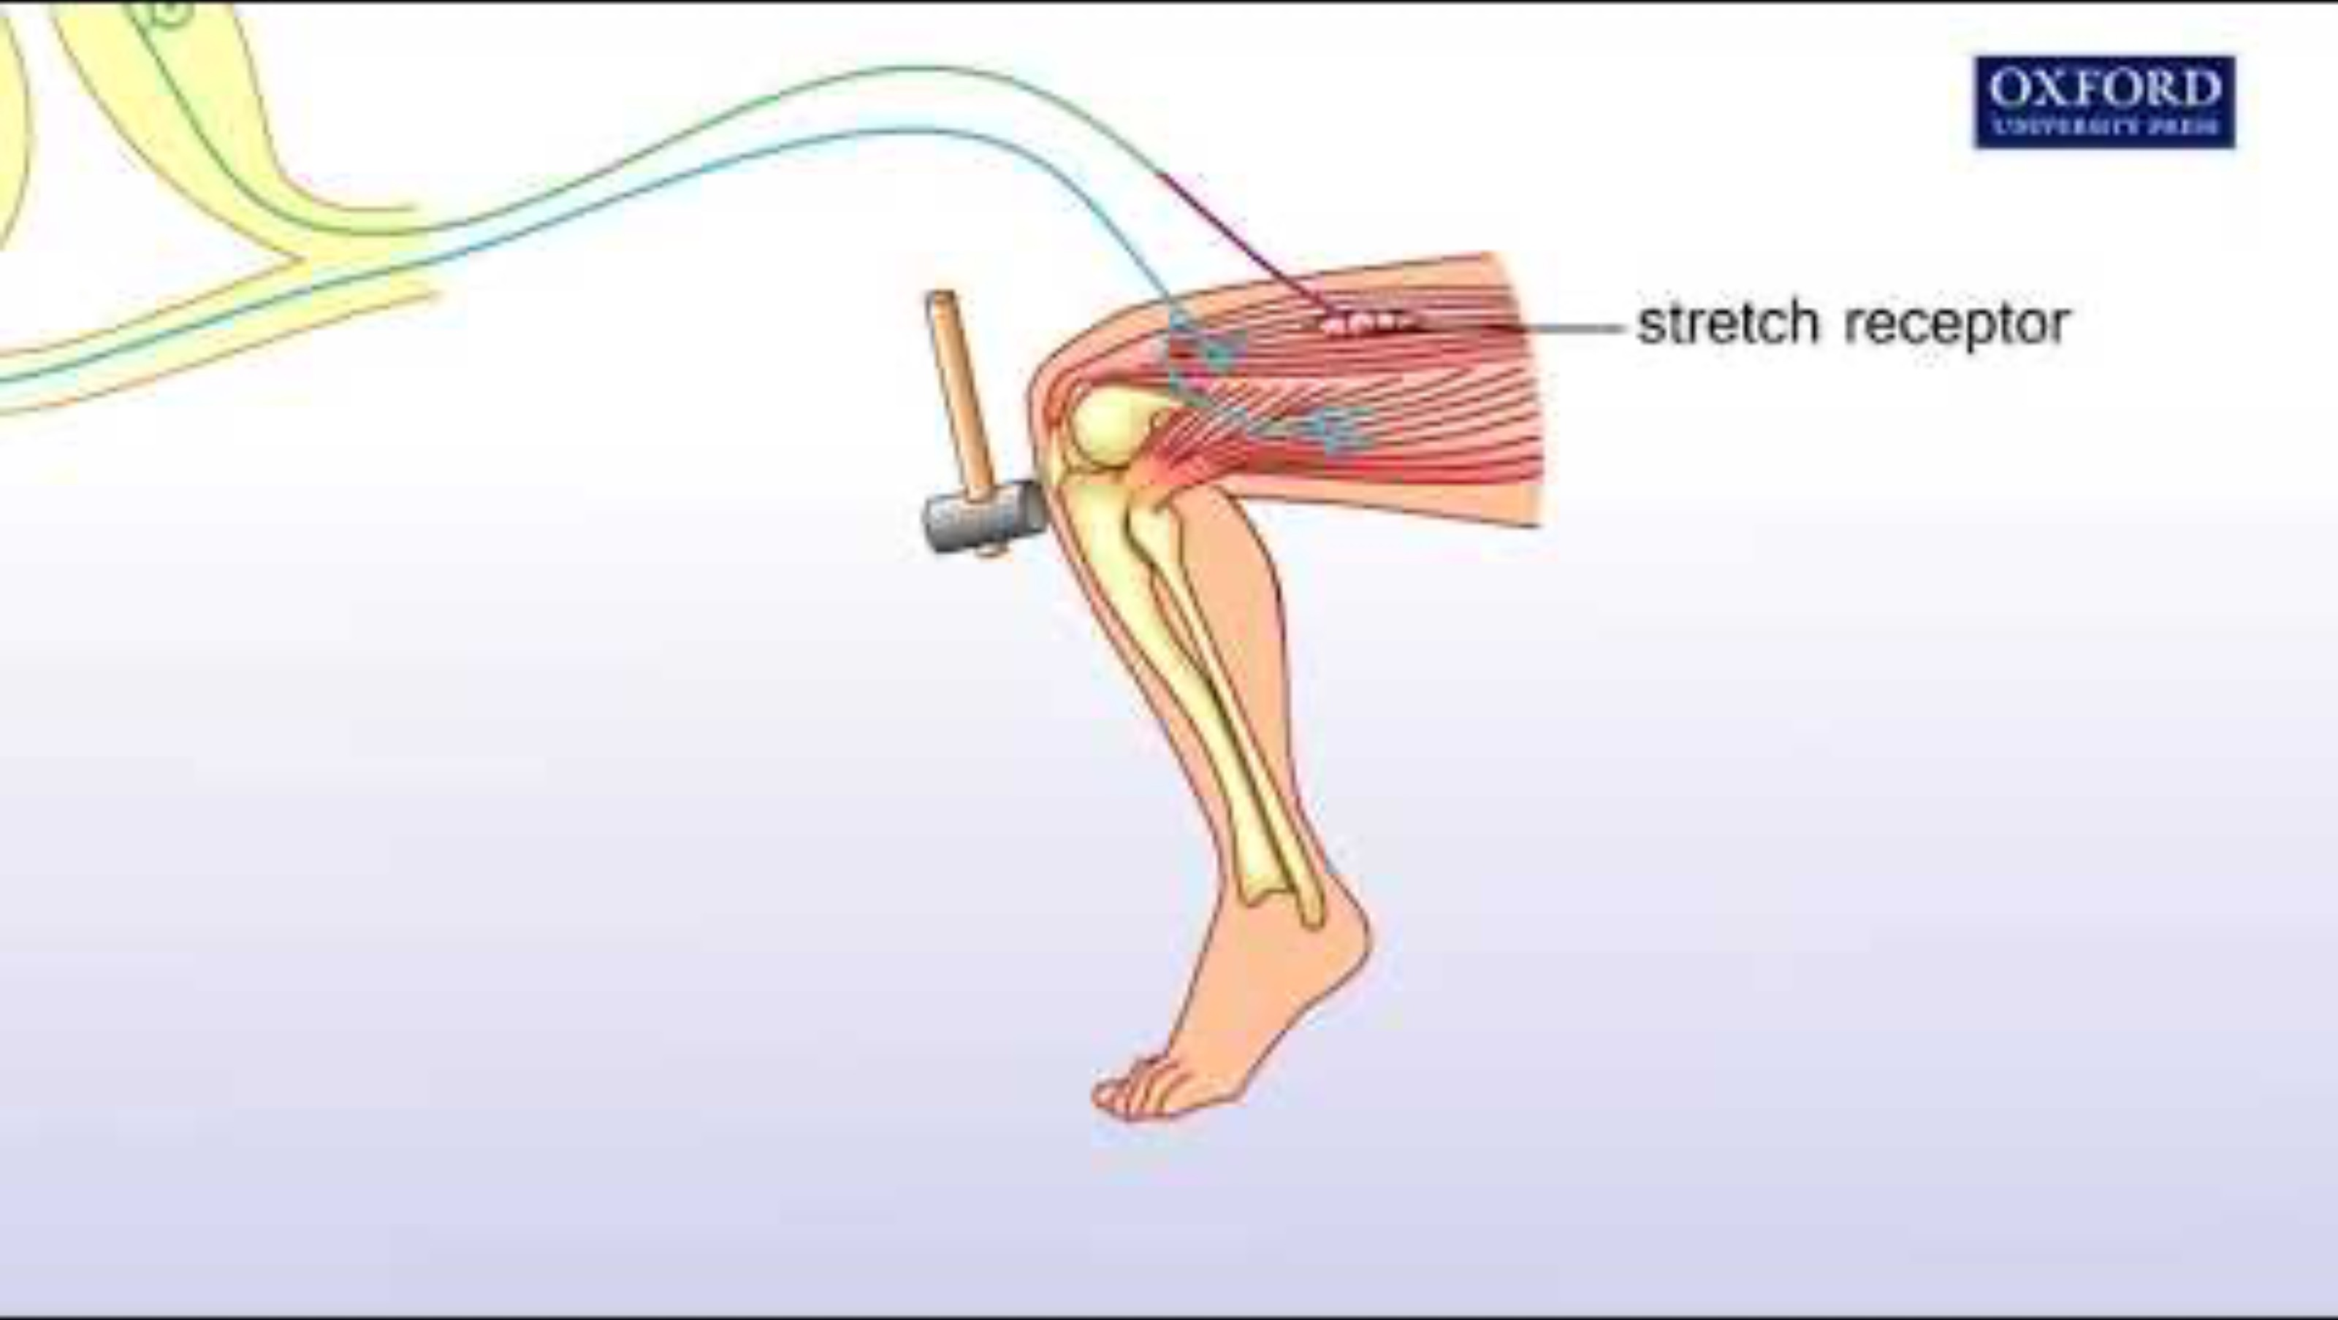
Knee jerk reflex mechanism
Notes:
https://youtu.be/DJLmVSeZ5-c

Slide 7
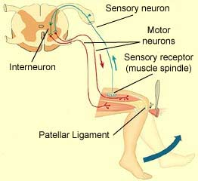
Notes:
https://thebrain.mcgill.ca/flash/i/i_01/i_01_cr/i_01_cr_fon/i_01_cr_fon.html

Slide 8
Artificial Neural Network -Neuron
Neuron
z = a1w1 +… a5w5 +…aKwK + b
a1
.
.
.
W1
.
.
.
z
a5
W5
+
a
.
.
.
σ (z)
.
.
.
WK
Activation Function
Output
aK
Weights
b
Inputs
Bias

Slide 9
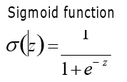
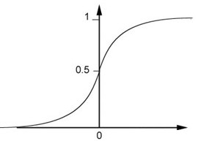
Artificial Neural Network -Neuron
Neuron
0.98
a1
.
.
.
W1
4
z
.
.
.
Z = 4
0.98
a5
W5
+
a
.
.
.
σ (z)
.
.
.
WK
Activation Function
Output
aK
Weights
b
Inputs
Bias

Slide 10

Popular activation functions

Slide 11
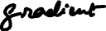

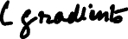
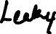
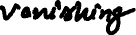
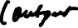
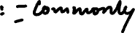
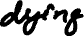
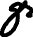
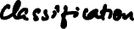
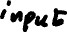
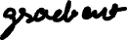
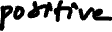
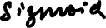
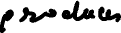
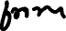
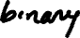
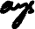
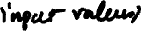
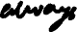
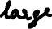
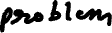
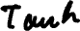

Slide 12
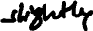
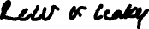
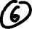
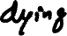
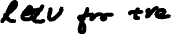
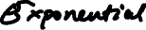
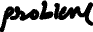
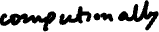
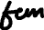

Slide 13
What does a neuron do?
Weigh
Sum
Transform

Slide 14
Part 2: Connect Neurons

Slide 15
Artificial Neural Network -Structure
Different Connections lead to different neural network structures
+
σ
(z)
b
σ (z)
+
σ (z)
+
b
b
+
σ
(z)
The neurons have different values of weights and biases.
b

Slide 16

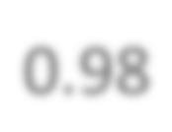



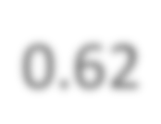
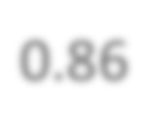







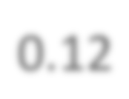


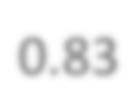
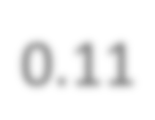






Artificial Neural Network -Structure
Fully Connected Feedforward Network
1
4
0.98 2
0.86
3
0.62
1
‐1
‐1
­‐2
1
0
-­‐2
­‐1
1
0.12 -­2
-­1
‐1
4
0.83
‐2
0.11
‐1
0
0
2

Slide 17
Artificial Neural Network -Structure
Fully Connected Feedforward Network

Slide 18
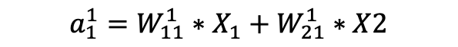
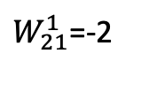
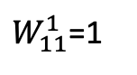
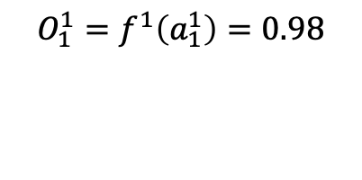
Artificial Neural Network -Structure
Fully Connected Feedforward Network
0.98
$W_{11}^{1}$=1
3
1
$W_{21}^{1}$=-2
‐1
Inputs
Activation
$${a_{1}^{1}=W}_{11}^{1}∗X_{1}+W_{21}^{1}∗X2$$
$${O_{1}^{1}=f}^{1}\left(a_{1}^{1}\right)=0.98$$
3 = 1*1+(-2)*(-1)
Notes:
W_{11}^1

Slide 19
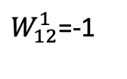



Artificial Neural Network -Structure
Fully Connected Feedforward Network
0.98
$W_{11}^{1}$=1
3
1
$W_{12}^{1}$=-1
0.12
$W_{21}^{1}$=-2
‐2
‐1
$W_{22}^{1}$=1
Inputs
Activation
$${a_{1}^{1}=W}_{11}^{1}∗X_{1}+W_{21}^{1}∗X2$$
$$a_{2}^{1}=W_{12}^{1}∗X1+W_{22}^{1}∗X2$$
$${O_{1}^{1}=f}^{1}\left(a_{1}^{1}\right)=0.98$$
3 = 1*1+(-2)*(-1)
-2 = (-1)*1 +1*(-1)
${O_{2}^{1}=f}^{1}\left(a_{2}^{1}\right)$ = 0.12
Notes:
W_{11}^1

Slide 20








Artificial Neural Network -Structure
Fully Connected Feedforward Network
0.98
0.86
$W_{11}^{1}$=1
3
1
$$W_{11}^{2}=2$$
$W_{12}^{1}$=-1
0.12
$W_{21}^{1}$=-2
‐2
$$W_{21}^{2}=−2$$
‐1
$W_{22}^{1}$=1
Inputs
Activation
$${a_{1}^{2}=W}_{11}^{2}∗O_{1}^{1}+W_{21}^{2}∗O_{2}^{1}$$
$${O_{1}^{2}=f}^{1}\left(a_{1}^{2}\right)=0.86$$
1.72 = 2*0.98 + (-2)*0.12
Notes:
W_{11}^1

Slide 21






Artificial Neural Network -Structure
Fully Connected Feedforward Network
0.98
0.86
$W_{11}^{1}$=1
3
1
$$W_{11}^{2}=2$$
$W_{12}^{1}$=-1
$$W_{12}^{2}=−1$$
0.12
0.11
$W_{21}^{1}$=-2
‐2
$$W_{21}^{2}=−2$$
‐1
$W_{22}^{1}$=1
$$W_{22}^{2}=−1$$
Inputs
Activation
$${a_{1}^{2}=W}_{11}^{2}∗O_{1}^{1}+W_{21}^{2}∗O_{2}^{1}$$
$$a_{2}^{2}=W_{12}^{2}∗O_{1}^{1}+W_{22}^{2}∗O_{1}^{1}$$
$${O_{1}^{2}=f}^{1}\left(a_{1}^{2}\right)=0.86$$
1.72 = 2*0.98 + (-2)*0.12
-1.1 = (-1)*0.98 + (-1)*0.12
${O_{2}^{2}=f}^{2}\left(a_{2}^{2}\right)$ = 0.11
Notes:
W_{11}^1

Slide 22







Artificial Neural Network -Structure
Fully Connected Feedforward Network
0.98
0.86
0.62
$W_{11}^{1}$=1
3
$$W_{11}^{3}=3$$
1
$$W_{11}^{2}=2$$
$W_{12}^{1}$=-1
$$W_{12}^{2}=−1$$
0.12
0.11
$$W_{21}^{3}=−1$$
$W_{21}^{1}$=-2
‐2
$$W_{21}^{2}=−2$$
‐1
$W_{22}^{1}$=1
$$W_{22}^{2}=−1$$
Inputs
Activation
$${a_{1}^{3}=W}_{11}^{3}∗O_{1}^{2}+W_{21}^{3}∗O_{2}^{2}$$
$${O_{1}^{3}=f}^{2}\left(a_{1}^{3}\right)=0.62$$
2.74 = 3*0.86+(-1)*0.11
Notes:
W_{11}^1

Slide 23








Artificial Neural Network -Structure
Fully Connected Feedforward Network
0.98
0.86
0.62
$W_{11}^{1}$=1
3
$$W_{11}^{3}=3$$
1
$$W_{11}^{2}=2$$
$W_{12}^{1}$=-1
$$W_{12}^{3}=−1$$
$$W_{12}^{2}=−1$$
0.12
0.11
$$W_{21}^{3}=−1$$
0.83
$W_{21}^{1}$=-2
‐2
$$W_{21}^{2}=−2$$
‐1
$W_{22}^{1}$=1
$$W_{22}^{2}=1$$
$$W_{22}^{3}=4$$
Inputs
Activation
$${a_{1}^{3}=W}_{11}^{3}∗O_{1}^{2}+W_{21}^{3}∗O_{2}^{2}$$
$$a_{2}^{2}=W_{12}^{3}∗O_{1}^{2}+W_{22}^{3}∗O_{1}^{2}$$
$${O_{1}^{3}=f}^{3}\left(a_{1}^{3}\right)=0.62$$
2.47 = 3*0.86+(-1)*0.11
-0.42 = (-1)*0.86+4*0.11
${O_{2}^{3}=f}^{3}\left(a_{2}^{3}\right)$ = 0.83
Notes:
W_{11}^1

Slide 24

Artificial Neural Network -Structure
Deep Neural Network: Many hidden layers

Slide 25

Training Data
Images and their labels

Slide 26



Artificial Neural Network –Application Example
Handwriting Digit Recognition

Slide 27
Summary
How human neurons work
How artificial neurons work
Weight, biases, activation function
What is a neural network
Input layer, hidden layer, output layer
How neural networks make predictions

Slide 28
Train a Neural Network Using Backpropagation
Gordon Gao
Carey Business School Professor

Slide 29
Artificial Neural Network -Structure
Deep Neural Network: Multiple hidden layers

Slide 30



Learning Target

Slide 31


Total Loss
For all training data:
Learning

Slide 32
Artificial Neural Network -Neuron
Neuron
a1
.
.
.
W1
z
.
.
.
Z = 4
0.98
ak
Wk
+
σ
(z)
a
.
.
.
.
.
.
WK
Activation Function
Output
aK
Weights
b
Bias
Inputs

Slide 33


How to find the best function
Gradient Descent
Total Loss

Slide 34

How to find the best function
Gradient Descent
34

Slide 35

How to find the best function
Gradient Descent

Slide 36
Back propagation

Slide 37


How to find the best parameters
This is the “learning” of machines in deep learning ……
Gradient Descent
But no guarantee:
Potential local minima issues with different initial points
Random start, hopefully we could reach the global minima

Slide 38
Local vs Global Optimal
Total Loss
A
B

Slide 39
How to unstuck and keep learning
Follow the momentum from previous steps
-> Adam optimizer for gradient descent
Total Loss
A
B

Slide 40


What determines a neural network’s performance
Structure of the neural network:
layers and connections
Activation function
Ex: ReLU or Sigmoid
Parameters (w and b)
back propagation

Slide 41
https://neuralnetworksimulator.onrender.com/
Observe the forward and backpropagation process
Think:
How is this different than human brains in “learning”?

